Slide 1

H&B NA Global Data Management: Metrics Report
May 2021
Published June 2021

Slide 2
Executive Summary
PEOPLE
PRODUCTIVITY
RESOURCING
H&B NA Global Team has {{Ppl1}} colleagues as of {{Ppl2}} {{Ppl3}}.
{{Prd1}}% YTD Productivity
(CY20 Goal: {{Prd2}}%)
{{Res1}} colleagues from Data Management supporting {{Res2}} processes. {{Res3}} more processes are expected for transition. See Slide 18 for the list.
{{Res4}}
Colleagues supporting Central Data Team
{{Res5}}
Colleagues supporting RFP / Carrier Ops
{{Res6}}
Colleagues supporting CCMU
{{Res7}}
Colleagues supporting RX Collaborative
{{Res8}}
Colleagues to support WillisMed
The H&B NA Global Team MTD productivity in December is at {{Prd3}}%.
{{Prd4}} clients are currently supported and {{Prd5}} more are to be transitioned.
{{Ppl4}}% Attrition YTD Rate
Colleagues who are loaned to other HCB LOBS (HC Equivalent)
{{Res9}}
*excludes contractual worker (CWK)

Slide 3
H&B NA Manila Team Risk Management
Overall risk rating of H&B NA Manila Team as of December 2020 is ON TRACK. Identified measures for each risk area do not reflect any critical risk to the business that may potentially impact the team’s deliverables.
Risk Area | Rating | Metrics
Clients | Ongoing Actions | Status quo on the following – (1) Continuous follow up made for clients with pending kick off calls including Wave 4 accounts (2) Initiated discussion and identified resources from existing team to support pilot accounts for B&A work
Financials | Ongoing Actions | Status quo on the following (1) Utilizing existing colleagues to support new work within H&B NA (i.e. CDT, CCMU, Carrier Ops, RxC) (2) Supported the following HCB segments to increase team utilization -- T&R Survey Loading, H&B NNA, (RIC) BDS, GBM (3) Capacity Modeler for B&A work
People | On Track | Ongoing recruitment for 2021 expansion
Excellence | On Track | Ongoing review of training curriculum

Slide 4
Financials
H&B NA Global Data Management Productivity {{Y1}}
{{M1}} MTD
{{P2}}%
The overall YTD productivity of H&B NA Manila as of {{M1}} {{Y1}} is at {{P1}}%. There is a sustained increase in volume for HBNA activities for DM and Non-DM Processes in Q1 2021 compared to Q1 2020. Productivity without New Hires HBNA US W4, Canada W1
Further breakdown per group are shown in the succeeding slides.
75%

Slide 5
Financials
The overall YTD productivity of H&B NA Manila as of {{M1}} {{Y1}} is at {{P2}}%. There is an increase in volume for HBNA activities for DM and Non-DM Processes in Q2 2021 compared to Q2 2020. Productivity without New Hires HBNA US W4, Canada W1;
*Forecast updated using new calculation model based on Team Capacity and Required Man Hours
H&B NA Global Data Management Productivity {{Y1}}
{{M1}} MTD
{{P1}}%
75%

Slide 6
Financials
The overall YTD productivity of H&B NA Manila as of {{M1}} {{Y1}} is at {{P2}}%. Increasing trend for HBNA activities for DM and Non-DM Processes in 2021. Productivity without New Hires HBNA US W4, Canada W1;
*Forecast updated using new calculation model based on Team Capacity and Required Man Hours
H&B NA Global Data Management Productivity {{Y1}}
{{M1}} MTD
{{P1}}%
75%

Slide 7
Financials
Chart below shows Productivity Comparison per Wave;
Wave 4 showing 99%+ Productivity due to training and parallel processing
*Forecast updated using new calculation model based on Team Capacity and Required Man Hours
H&B NA Global Data Management Productivity 2021
June MTD
87%
75%

Slide 8
Financials
The overall YTD productivity of H&B NA Manila as of {{M1}} {{Y1}} is at {{P2}}%. There is an increase for HBNA activities: DM and Non-DM Processes in Q2 2021 vs Q2 2020. Productivity without New Hires HBNA US W4, Canada W1
*Forecast updated using new calculation model based on Team Capacity and Required Man Hours
H&B NA Global Data Management Productivity {{Y1}}
{{M1}} MTD
{{P1}}%
75%

Slide 9
Financials
Data Management
{{M1}} MTD
{{P2}}%
{{Y1}} YTD utilization is at {{P1}}%. MTD results include utilization from other HCB teams and H&B NA client work. Resources are also cross-utilized to CDT, CCMU, Carrier Operations.
75%
Y20 Y21 Q120 Q121 Jan Feb Mar Apr May YTD Goal
There is an increase in volume for HBNA activities for DM and Non-DM Processes in 2021 compared to 2020.

Slide 10
Financials
Central Data Team
{{M1}} MTD
{{P2}}%
In {{M1}}, productivity was driven by RFP Related activities and the Global Network Team: GeoAccess, Disruption Analysis and NetRPM activities as well as ADML RFPs/Benchmarking; CCMU Reporting and Vetting; Form 5500. YTD Utilization is {{P1}}%.
70%
To date, CDT actively works on ADML Benchmarking, ADML RFP, Network, NDT, CCMU and Form 5500s. Form 5500 is currently on peak season from April to July. GeoAccess and Disruption Analysis ongoing for several RFP clients.

Slide 11
Financials
RFP Team
{{M1}} MTD
{{P2}}%
We received a total of {{N1}} RFPs accounts in {{M1}} and {{N2}} RFPs total YTD 2021. Low work volume with Carrier Operations expected for 1H {{Y1}}. Project coordinators spent most of their time with RFP work. YTD Utilization is at {{P1}}%.
75%
We continued to work on monitoring mailboxes and sending Priority emails for Carrier Operations. We received an additional 5 RFPs for month of May 2021. Stop Loss RFP Ongoing in May 2021. Tentative Placement RFP work from B&A pending training and transition around July 2021.

Slide 12
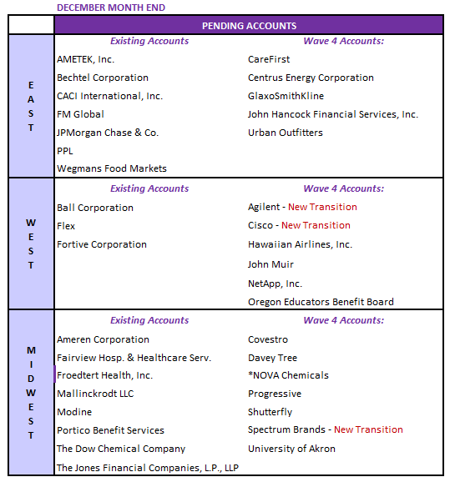
Financials
Client Transition Update
Account Status | EAST | WEST | MIDWEST | TOTAL
Existing | 144 | 131 | 110 | 385
Pending | 12 | 9 | 15 | 36
Pending accounts down to 36 by December ME
  17 accounts from Waves 1-3; 16 accounts from Wave 4
  3 new transitioned accounts
WAVE 4 STATUS | EAST | WEST | MIDWEST | TOTAL
Active | 8 | 9 | 5 | 22
Kick-Off Scheduled | 2 |  |  | 2
Kick-Off Completed; Pending Activity |  | 1 | 3 | 4
Pending Kick-Off Call | 5 | 5 | 4 | 14
Moved to US DMT/B&A |  | 1 | 1 | 2
Terminated |  | 2 |  | 2
TOTAL | 15 | 18 | 13 | 46
  Total of 46 accounts under Wave 4 as of this writing
    27 Initial Transition
    19 Additional accounts
    48% already active, 43% pending activity, 9% terminated/moved to US DMT
**Please see attached file for full details

Slide 13
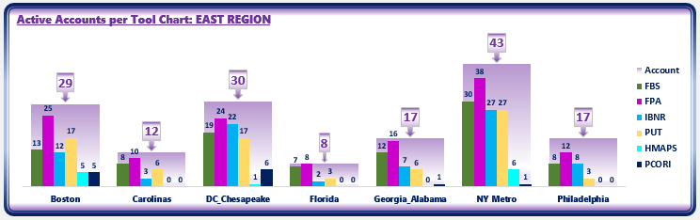
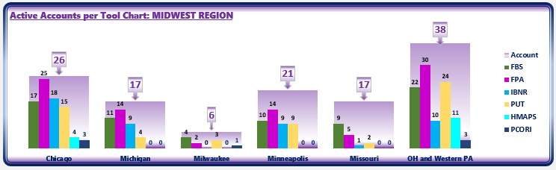
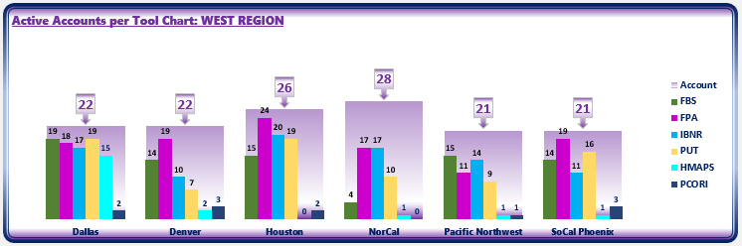
Financials
Volume Per Office: (FPA, FBS, HMAPS, PUT, IBNR, PCORI)
{{Text1}}
{{Text2}}
{{Text3}}
Notes:
Tables represent the number of accounts per office with corresponding activity per reporting tool

Slide 14
Excellence
Volume Analysis
2020 TARGET vs ACTUAL TOOL SUBMISSION
 | FBS | FPA | IBNR | PUT | TOTAL
Rounds | 261 | - | - | - | 261
Annually | - | 14 | 112 | 215 | 341
Semi-Annually | - | 4 | 63 | 150 | 217
Quarterly | - | 166 | 419 | 112 | 697
Monthly | - | 3267 | - | - | 3267
TARGET | 261 | 345 | 594 | 477 | *4871
ACTUAL | 261 | 2468 | 506 | 289 | *3612
VARIANCE | - | -983 | -88 | -188 | -1259
2020 TOOL SUBMISSION PENDING CONFIRMATION
 | FBS | FPA | IBNR | PUT | TOTAL
Pending Clients | 40 | 56 | 82 | 74 | 252
No Work | 15 | 24 | 85 | 35 | 159
US Team | 97 | - | - | - | 97
The Manila Data Management Team has completed a total of 3,612 reports for 389 client accounts for 2020 YTD
Teams completed 1364 reports for the East region, 827 for Midwest region and 1421 for West region
*includes +33 PCORI and +55 HMAPS YTD

Slide 15
Excellence
Average Handling Time (AHT) Analysis
{{TEXT1}}
{{TEXT2}}
Notes:
Trend of AHT per month per tool
AHT against volume

Slide 16
Excellence
Average Handling Time (AHT) Analysis | Consulting vs B&A
Notes:
Trend of AHT per month per tool
AHT against volume

Slide 17
Excellence
Average Handling Time per Tool per Market May 2021 (Combined B&A and Consulting)
Notes:
Trend of AHT per month per tool
AHT against volume

Slide 18
Excellence
Average Handling Time per Tool per Market May 2021 (B&A)
Notes:
Trend of AHT per month per tool
AHT against volume

Slide 19
Excellence
Average Handling Time per Tool per Market May 2021 (Consulting)
Notes:
Trend of AHT per month per tool
AHT against volume

Slide 20
Excellence
Average Handling Time (AHT) Analysis – Central Data Team
Processes with the lowest handle time are CCMU Reporting and NetRPM (B&A and Consulting) due to the high volume of reports compared to the other processes. In addition, NetRPM requests are transactional in nature – requires minimal project management work and with shorter timelines. Complexity is considered simple for both processes.
Processes with higher handle time are ADML Benchmarking, ADML RFP, NDT (B&A and Consulting), CCMU Vetting, GeoAccess and Disruption Analysis. Complexity is higher due to required data manipulation, analysis and deck preparation. These also involve longer timelines due to data dependencies from different sources
No AHT for Form 5500 (no Jira Workflow)
Notes:
Trend of AHT per month per tool
AHT against volume

Slide 21
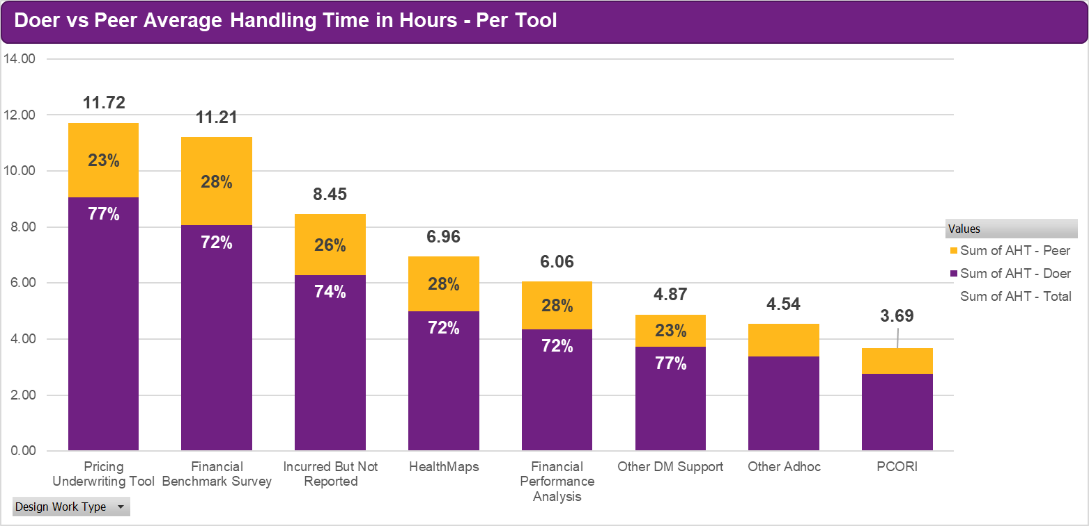
Excellence
AHT per Process (Data Management) 2021
Notes:
Trend of AHT per month per tool
AHT against volume

Slide 22
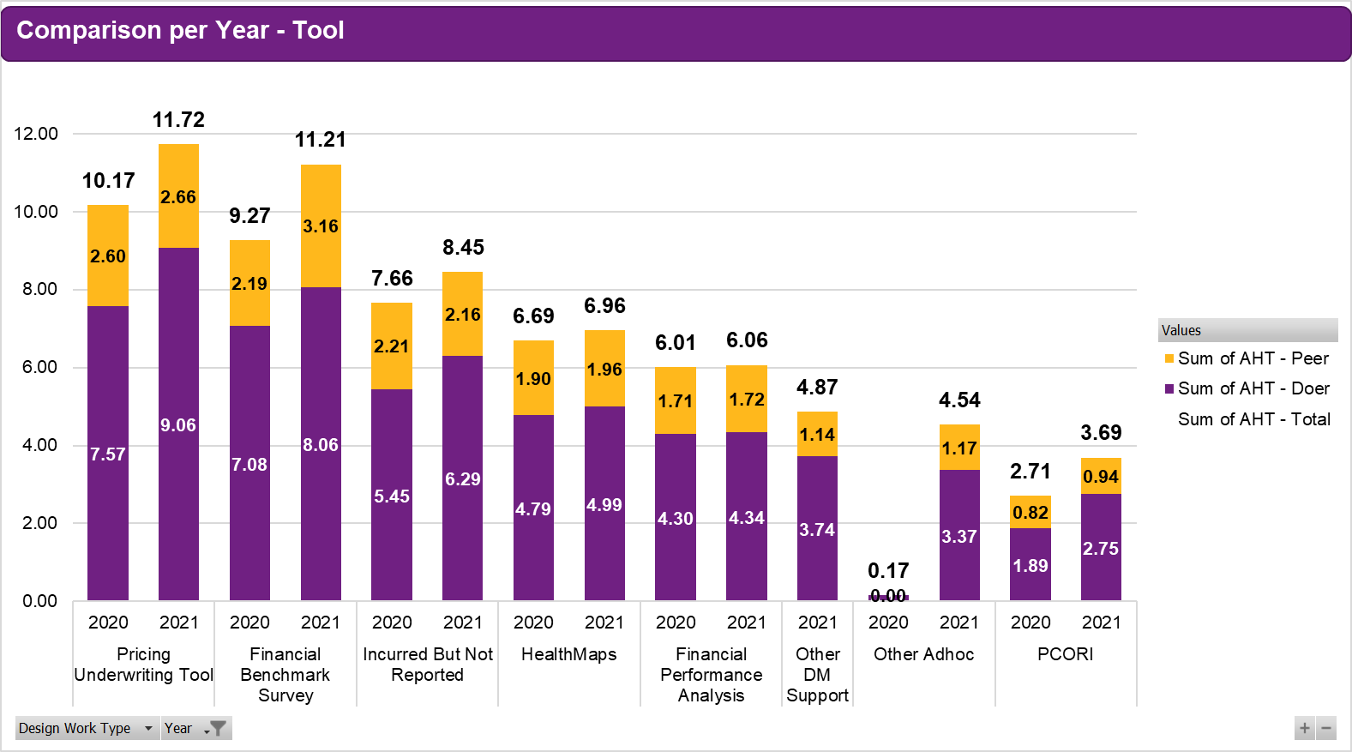
Excellence
Increase in AHT for PUT, FBS, IBNR, HealthMaps and PCORI 2021 vs 2020
FPA AHT slightly improved in 2021 vs 2020
AHT per Process (Data Management) 2021 vs 2020
Notes:
Trend of AHT per month per tool
AHT against volume

Slide 23
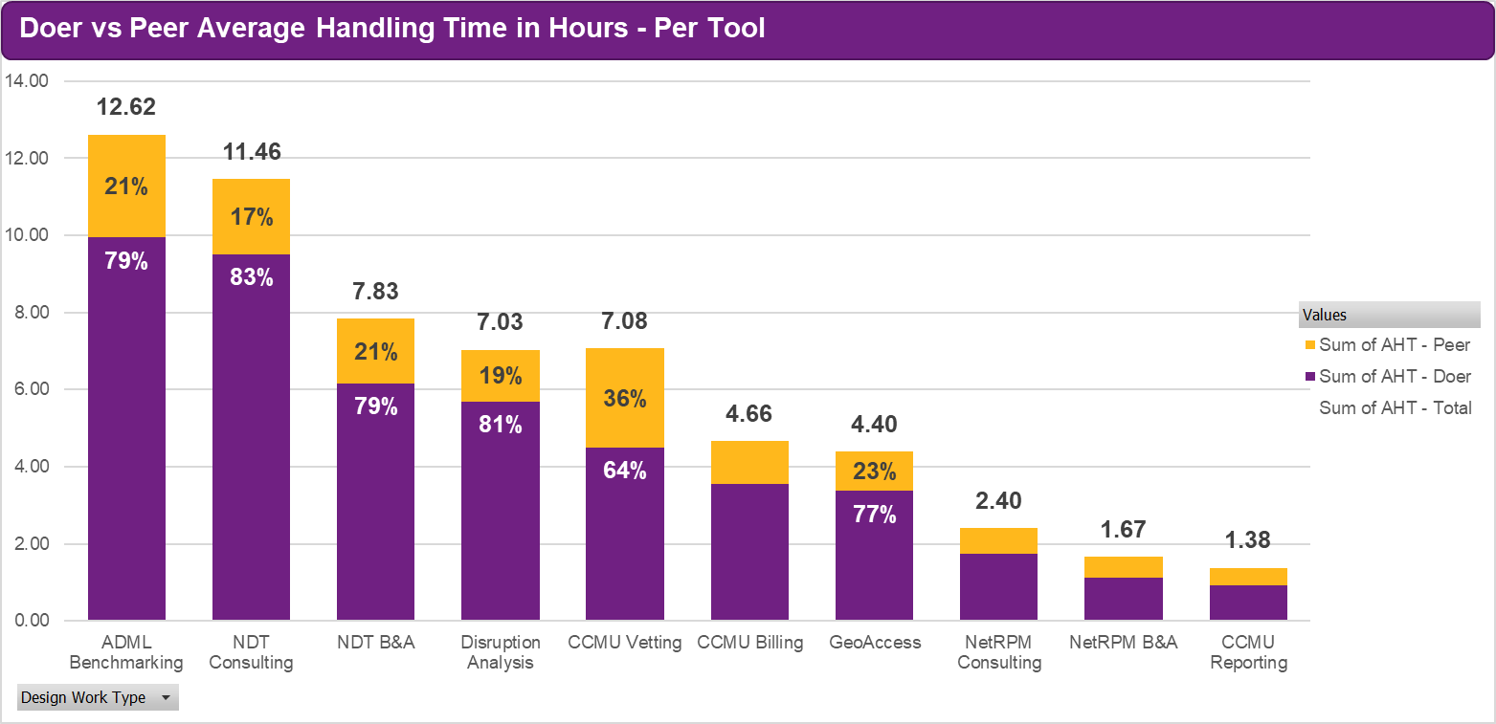
Excellence
AHT per Process (Central Data Team) 2021
Notes:
Trend of AHT per month per tool
AHT against volume

Slide 24
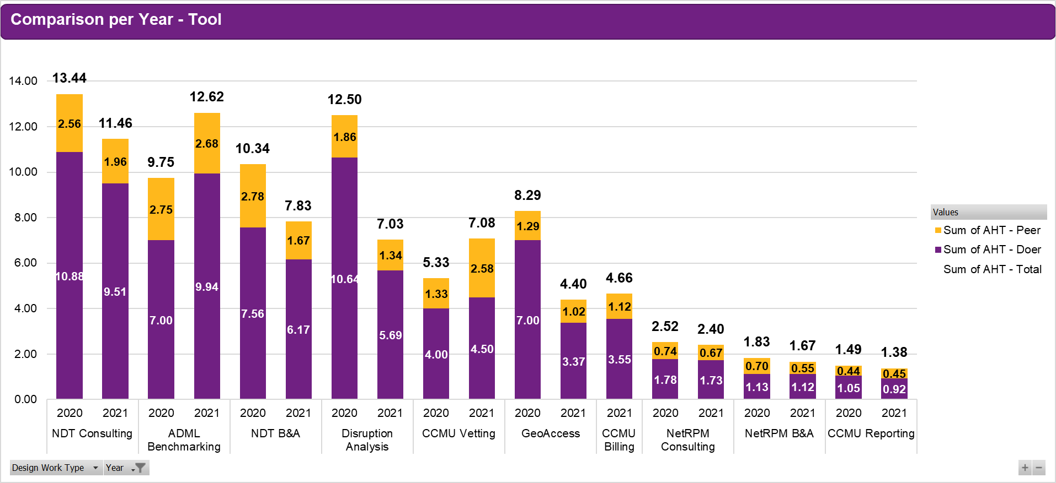
Excellence
Increase in AHT for ADML Benchmarking and CCMU Vetting 2021 vs 2020
Rest of CDT Processes AHT improved in 2021 vs 2020
AHT per Process (Central Data Team) 2021 vs 2020
Notes:
Trend of AHT per month per tool
AHT against volume

Slide 25
Clients
Volume
Process | Metric | May ‘20 | May ’21 | 2021 YTD
FBS | Completed Projects | - | - | 260
FPA | Completed Projects | 94 | 57 | 1851
IBNR | Completed Projects | 26 | 11 | 325
PUT | Completed Projects | 4 | 4 | 278
HMaps | Completed Projects | - | 1 | 51
PCORI | Completed Projects | - | - | 33
CDT | ADML Benchmarking - Completed | 1 | 4 | 10
 | ADML RFP - Completed | 2 | 1 | 19
 | CCMU Billing - Completed | 0 | 1 | 11
 | CCMU Carrier Outreach - Completed | 0 | 0 | 0
 | CCMU Reporting - Completed | 3 | 1 | 69
 | CCMU Vetting - Completed | 0 | 1 | 10
 | GeoAccess – Completed | 0 | 5 | 33
 | Disruption Analysis – Completed | 0 | 7 | 31
 | NDT – B&A – Completed | 0 | 2 | 3
 | NDT Consulting - Completed | 0 | 2 | 12
 | NetRPM – B&A – Completed | 0 | 21 | 101
 | NetRPM – Consulting – Completed | 4 | 2 | 30
RFP | Completed RFP (All Types) | 0 | 5 | 77
RxC | Dispensing Fee Reconciliation | - | - | -
 | API Letter and Population of price grid for lettersRebate Reconciliation | - | - | -
Carrier Ops | Client Profiling – Completed | 0 | 0 | 39
 | SBC - Completed | 0 | 0 | 174
 | Benefit Summary - Completed | 0 | 0 | 140
Performance
Quality
Process | Metric | Dec ‘19 | Dec’ 20 | 2020 YTD | Feedback Rate *
FBS | % accurate projects vs. # of TR received | 98.08% | N/A | 97.78% | 86.30%
FPA | % accurate projects vs. # of TR received | 98.53% | 99.75% | 98.54% | 53.00%
IBNR | % accurate projects vs. # of TR received | 98.60% | 99.30% | 98.58% | 57.60%
PUT | % accurate projects vs. # of TR received | 95.45% | 100% | 97.57% | 71.10%
HMaps | % accurate projects vs. # of TR received | N/A | 100% | 97.84% | 61.10%
PCORI | % accurate projects vs. # of TR received | N/A | N/A | 98.74% | 84.80%
CDT (All process) | % accurate projects vs. # of TR received | N/A | N/A | 97.22% | 66.32%
*Feedback Rate = # of TR feedback received vs # of reports submitted to US client teams for TR
Timeliness
Process | Metric | Dec ‘19 | Dec’ 20 | 2020 YTD
FBS | % of projects meeting deadlines | 100% | 100% | 100%
FPA | % of projects meeting deadlines | 100% | 100% | 100%
IBNR | % of projects meeting deadlines | 100% | 100% | 100%
PUT | % of projects meeting deadlines | 100% | 100% | 100%
HMaps | % of projects meeting deadlines | 100% | 100% | 100%
PCORI | % of projects meeting deadlines | 100% | 100% | 100%
CDT Processes | % of projects meeting deadlines | 100% | 100% | 100%
RFP | % of projects meeting deadlines | 100% | 100% | 100%
Notes:
The Manila Data Management Team has completed a total of 3621 reports for 2020 YTD
Phase 1 - 2800
Phase 2 – 163
Phase 3 - 658

Slide 26
Excellence
Automation Projects
COMPLETED
Process | Tool/Project Name
Carrier Operations | Client Profile
Carrier Operations | Priority email assistance- automation
FPA | FPA Aggregator Tool
General RFPs | Standard RFP Census Request
Med/Den/Vis RFP | GeoAccess
Med/Den/Vis RFP | Provider Disruption Tool
ADML RFP | ADML Census/Volume Calculation
RxC | ESI Rebate Aggregator (PDF to Excel)
FBS | Demographics Analysis Tool
Ad Hoc | COVID US Worksite Analysis
Ad Hoc | COVID Analytics Excel->PPT
ONGOING
Process | Tool/Project Name
FPA | FPA Review Tool
FPA | FPA Aggregator Tool Error Checking
Ad Hoc | Payment Integrity Model
AMPlify (Canada) | Assist with import from PDF
RxC | ESI Reconciliation Tool
ADML RFP | ADML RFP Roll-up
Ad Hoc | Benefit Valuation
Form 5500 | Auto-Email
San Francisco Ordinance | Calculation Automation for several models; standardization
All completed projects were supported by JP Hernandez, Marlon Pilor and Bryan Baliday alongside Joe Allbright and were done on top of their regular work.
Currently with 1 project hire who is a dedicated full time VB expert.

Slide 27
Excellence
Automation Projects 2021
COMPLETED
Process | Tool/Project Name
HBNA | I&D Gap Tool
HBNA | PIE Metrics Tool
HBNA | Benefit Valuation
RxC | RxC Discount Aggregator
ONGOING
Process | Tool/Project Name
FPA | FPA Review Tool
FPA | FPA Aggregator Tool Error Checking
Ad Hoc | Payment Integrity Model
AMPlify (Canada) | Assist with import from PDF
ADML RFP | ADML RFP Roll-up Enhancement
Form 5500 | Auto-Email
San Francisco Ordinance | Calculation Automation for several models; standardization
Network Analyses | Disruption Template Improvement
ADML | ADML E-mail Tool
All completed projects were supported by JP Hernandez, Marlon Pilor and Bryan Baliday alongside Joe Allbright and were done on top of their regular work.
Currently with 1 project hire who is a dedicated full time VB expert.

Slide 28
Excellence
H&B NA Manila YTD Scope
Financial Data Management
FPA
Central Data
NetRPM
Non Discrimination Testing
Carrier Operations
Rx Collaborative
RFP
IBNR
PUT
FBS
HealthMaps
PCORI Fee
CCMU (Billing, Reporting, Vetting)
Client Profiling
Priority Email Assistance
Record Keeping
High Performing & Alternative Zip Code
Summary of Benefits & Coverage
API Letters
Population of Price Grid for letters
Reconciliation Results Aggregation
Medical
Dental
Vision
ID Theft
ADML
Rebate Reconciliation (ESI & CVS)
Retiree Medical per Capita
CCMU Ops and Sales Support
ADML Benchmarking
Legal
Network Summary
Benefit Set-Up
Geo Access
Disruption Analysis
WillisMed
Client Setup
Pending
Pending
Pending
Pending
Pending

Slide 29
Appendix

Slide 30
About This Report
The report provides a view into the team’s headcount, productivity and performance on client metrics. The report has been enhanced with data illustration and charting, analysis and forecast on productivity, resource management activities and insights.
In alignment with the new global time recording policy, the colleague capacity utilization details for all teams have been adjusted to the new classifications. For a summary of this new approach, please turn to slide 19.
Please send questions and/or clarifications regarding the report to WTW.HB.MNL.Financial.Team.Leaders@willistowerswatson.com
People
Financial
Excellence
Clients
Headcount
Productivity
Resourcing
Performance

Slide 31
Productivity Computation
70%
The productivity expectation is set at 70%
    Client Time + Approved Non-Client Time
Target
    Productivity % =
Team coordinators, senior team coordinators and managers are included in measuring monthly and year-to-date team utilization.
    Standard
    Working Hours
    40 hours per week, including public holidays
Client Time
Direct Client & Project Activities
Software Development, Delivery and Shared Services time recorded to HRT, GDS, EI, EC project codes
Project review meetings
Billable and Non-billable
Non-Client Time
T&R Ops Manila Operations Support Activity
Learning & Development
Non-Project Specific Task
General Management & Administration
All Time
Recorded
Non-Working Time
Holiday
Vacation Leave
Sick Leave
Maternity & Paternity Leave
Emergency Leave

Slide 32
People
Managers*
By Region | Headcount | YTD Attrition
West | 23 | 1
Midwest | 15 | 1
Southeast | 11 | 0
Northeast | 12 | 0
CDT | 10 | 0
RFP | 2 | 0
1%
1:5
Team Leaders*
8%
1:12
By Tenure | Headcount | YTD Attrition
< 1 year | 31% | 1
1-3 years | 68% | 1
4-5 years | 0% | 0
> 5 years | 1% | 0
91%
Analysts*
By Job Level | Headcount | YTD Attrition
68-83 | 78% | 1
58-63 | 21% | 1
48-53 | 1% | 0
Status quo for December
Attrition: 1 voluntary, 1 non-regularization

Slide 33
Feedback Rate YTD
Notes:
Notes:
Sum of TR Feedback – Number of reports (all tools) submitted with TR Feedback received from Client Team
Sum of No TR Feedback – Number of reports (all tools) submitted with no TR Feedback received
Sum of Reports Sent to Client – Total reports (all tools) sent to Client YTD
Average Response Rate – Sum of TR Feedback Received/Sum of Reports Sent to Client

Slide 34
Feedback Rate by Office (Q1 vs Q2)

Slide 35
FPA Feedback Rate by Office (Q1 vs Q2)

Slide 36
PUT Feedback Rate by Office (Q1 vs Q2)
Notes:
Notes:
Sum of TR Feedback – Number of PUT submitted with TR Feedback received from Client Team
Sum of No TR Feedback – Number of PUT submitted with no TR Feedback received
Sum of Reports Sent to Client – Total PUT sent to Client YTD
Average Response Rate – Sum of TR Feedback Received/Sum of Reports Sent to Client

Slide 37
IBNR Feedback Rate by Office (Q1 vs Q2)

Slide 38
FBS Feedback Rate by Office (Q1 vs Q2)

Slide 39
HealthMaps Feedback Rate by Office (Q1 vs Q2)

Slide 40
PCORI Feedback Rate by Office (Q1 vs Q2)

Slide 41
Total Quality Score (YTD)

Slide 42
Total Quality Score (Q1 vs Q2)

Slide 43
Total Quality Score (YTD)

Slide 44
Total Quality Score (YTD)

